Slide 1
Learning Management System
Team Name : Caterpillars
Team Members :
1. Lijo Daniel,
2. Vikas Sangwan

Slide 2
What is LMS?
A learning management system is a robust software application for the administration, documentation, tracking, reporting and delivery of eLearning education courses or online training programs.
LMSs can range from systems for managing training and educational records to software for delivering online or hybrid college courses.
In our context LMS is considered as a Q&A web service. It can be described as "mixture between a wiki and forum”

Slide 3
Problem Statement
No instant and convenient collaboration between learners.
No means to customize the content for different group of students in different courses.
No effective communication between tutors and students after the class.

Slide 4
Proposed solution
An LMS makes it easier to organize groups of learners, enabling class-based discussions, group work and peer support.
Provides courses using access rights and registration.
Targets content to the correct individuals or groups.
Scheduling of course learning events, learners, and resources.
Keeps tutors and his students engaged in discussion without interruption.

Slide 5
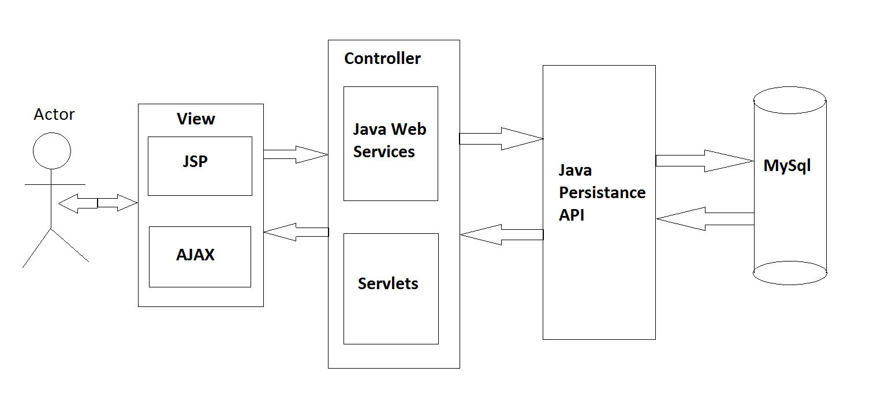
Architecture

Slide 6
Architecture (contd..)
In LMS, MySql is used to persist data. This data is accessed using JPA. We have used Eclipselink implementation of JPA which comes standard with Eclipse IDE.
This data is accessed by Java Web Service and servlets to respond to the requests made by the clients. Jersey is used as the JWS endpoint and Jackson is used to serialize java objects into JSON objects.
In LMS, AJAX has been used in most places to request data from the server. The response, JSON, is used to render the view on the browser. Rendering of UI is managed using jQuery.
We have used Twitter Bootstrap for UI.
This web application is hosted using Apache Tomcat.

Slide 7
Architecture (contd..)
S.No. | Layer | Technology | Comments
1. | Backend | MySql | Version 5.6
2. | Middle Tier | JPA | EclipseLink 2.5.2
3. | Controller | JWS | Jersey 1.1.8
4. | Controller | Servlet | Dynamic Web Module 3.0
5. | View | JSP | Dynamic Web Module 3.0
6. | View | Ajax | jQuery 1.11.1
7. | Server | Apache Tomcat | Version 7.0.56
8. | Frontend | Bootstrap(css plug in)

Slide 8
Use Case Diagram

Slide 9
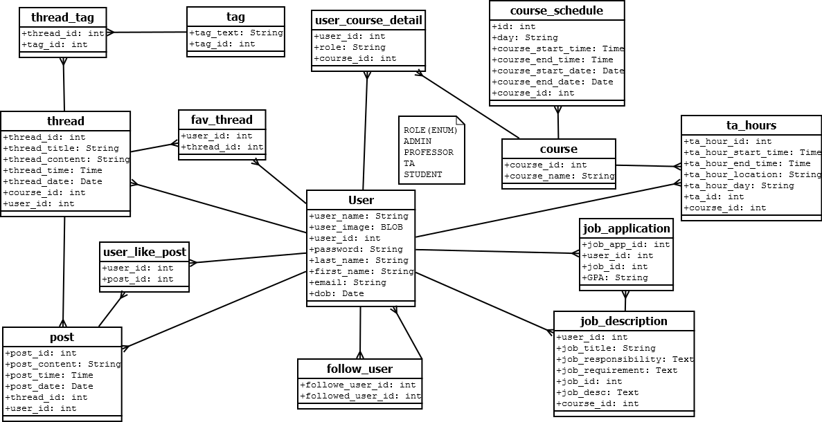
Class Diagram

Slide 10
Scope of Improvement
User should be able to deactivate/delete his account from the system.
Thread/Post should be editable and deleteble.
Professor should be able to remove student from the list of TA.
Student should be able to anonymously post questions and answers.

Slide 11
Questions ??

Slide 12
Thank you

